Slide 1
Expense Tracker
GROUP MEMBERS
S.No. | Enrollment # | Student Name
1 | 02-131222-083 | Syed Fahad Ali Gillani

Slide 2
Table of Contents
Introduction
Abstract
Features
Methodology
Technologies
Project Scope
Interface
Reference

Slide 3
Introduction
Our lives are becoming increasingly complex, and with that comes the need for better financial management tools. In line with this, we propose to develop an Expense Tracker using ASP.NET C#. This system aims to provide users with a robust platform to track their expenses and incomes efficiently, facilitating informed decision-making and financial planning.

Slide 4
Abstract
The Expense Tracker is a web-based application developed using ASP.NET C# that enables users to track their financial transactions conveniently. With features such as expense categorization, income tracking, and comprehensive reporting, the system empowers users to manage their finances effectively. By providing a user-friendly interface and robust data security measures, the system aims to simplify the process of financial management for individuals and businesses alike.

Slide 5
Features In Proposed Solution
User Registration and Authentication: Secure user registration and login system to access the application.
Expense Tracking: Ability to manipulate expenses with customizable categories and optional attachments.
Income Tracking: Capability to manipulate different sources of income.
Dashboard: Provide users with an overview of their financial status through summarized data.

Slide 6
Methodology
Database Design
User Registration Module
Expense Tracking Module Development
Categories Module Development
Dashboard Module Development

Slide 7
Technologies
Visual Studio
C#
ASP.NET
HTML
CSS
JAVASCRIPT

Slide 8
Project Scope
The scope of the project includes the development of a fully functional web application that allows users to:
Register and log in securely to their accounts.
Manipulate expenses with customizable categories.
Track various sources of income.
View summarized reports of expenses and incomes.
Implement role-based access control to manage user permissions.
Ensure data security through encryption and secure authentication mechanisms.

Slide 9
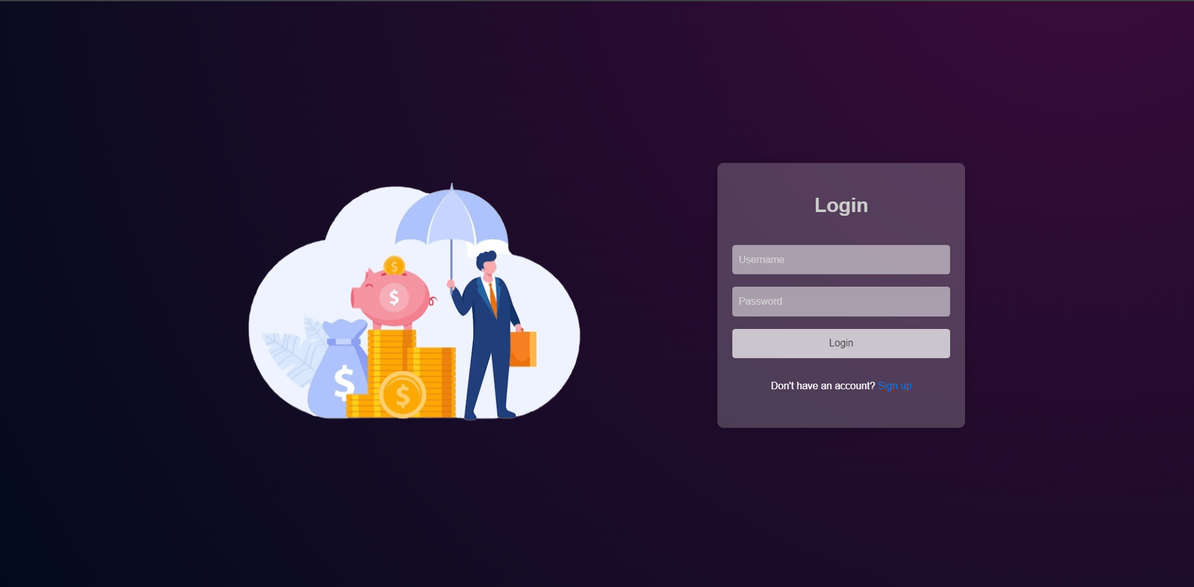
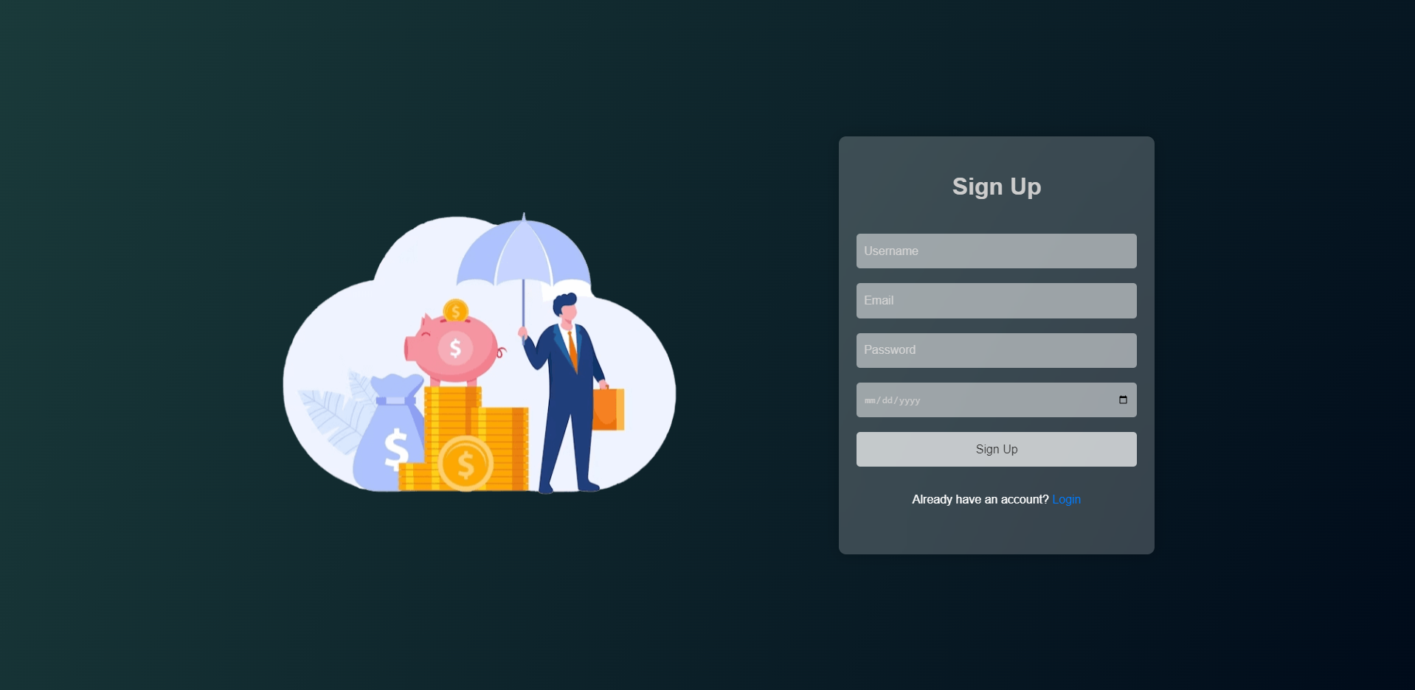
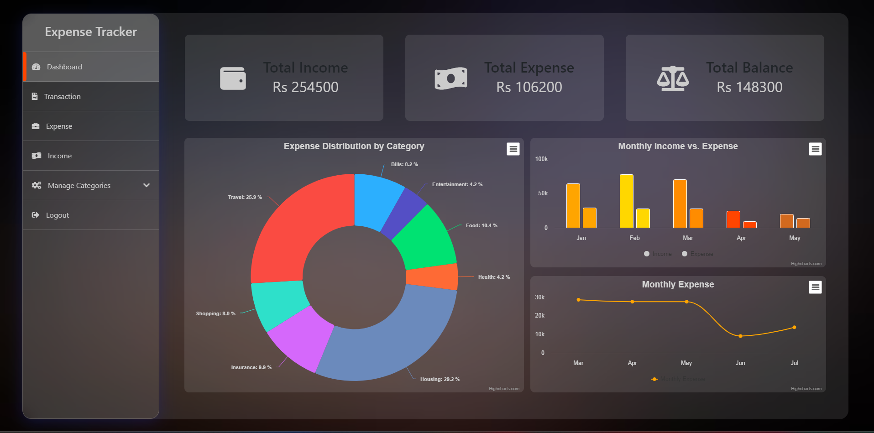
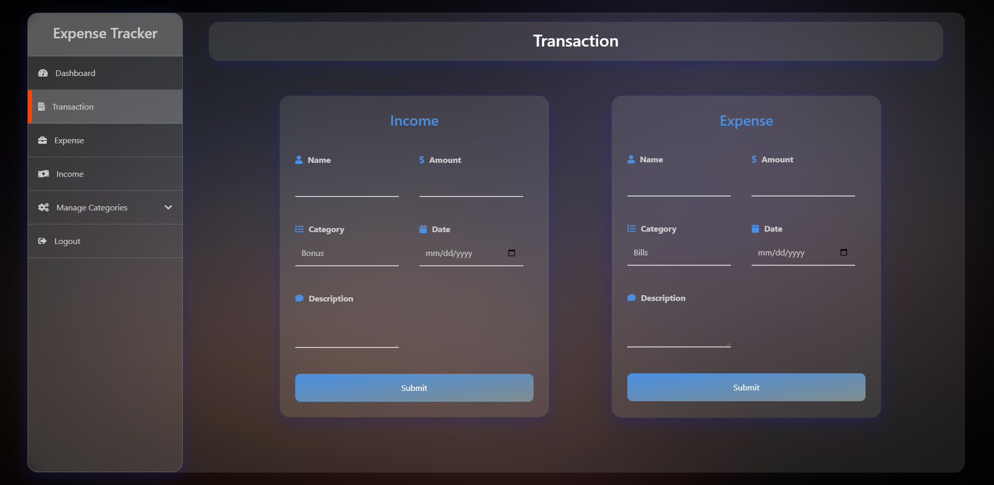
Interface

Slide 10
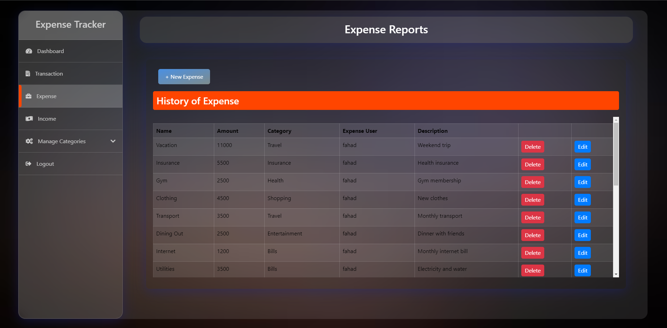
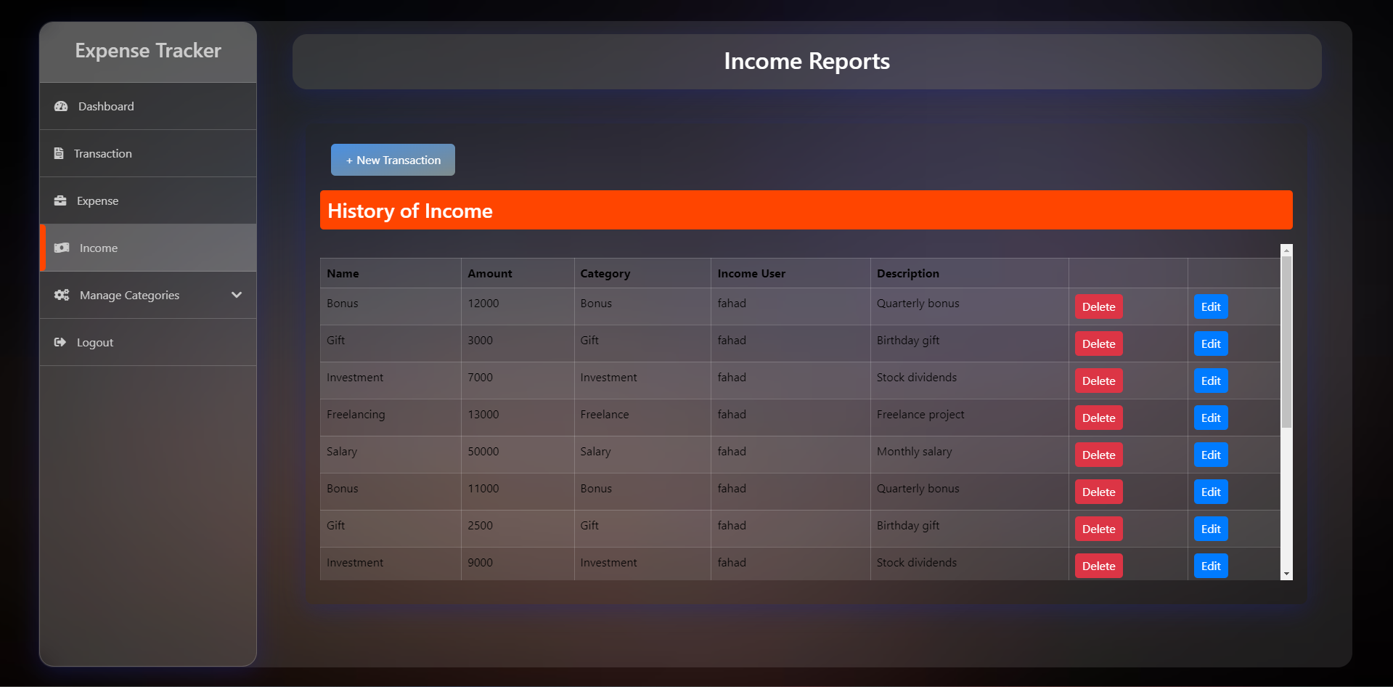
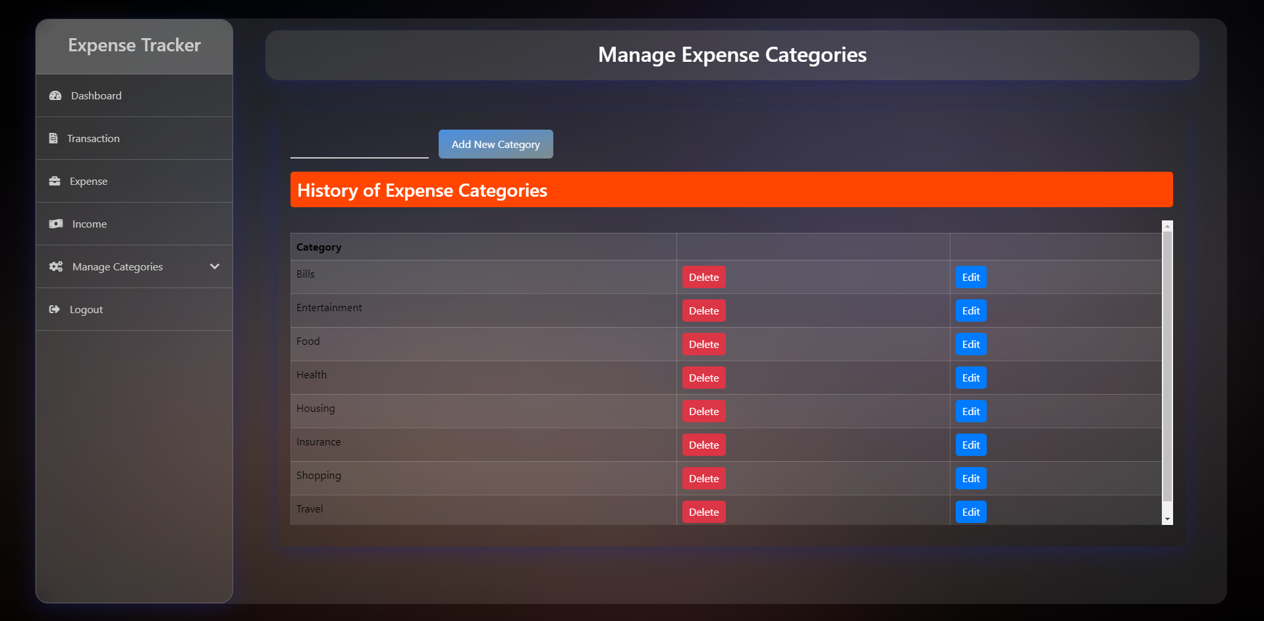
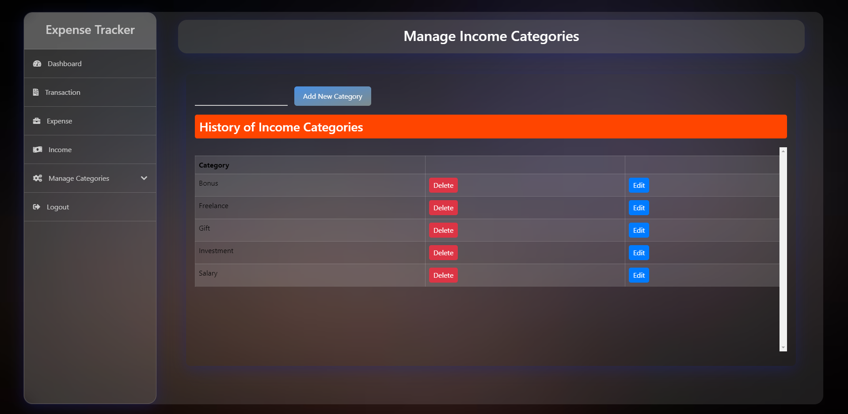
Interface

Slide 11
Reference
https://drive.google.com/drive/folders/1QcYWAa5g3f2tqWfS4yG41jvz10isMC-y

Slide 12
Thank You!

